Slide 1

ADS Team 12 Final Project
Twitter Sentiment Streaming Analysis
Website: https://agarwal123.shinyapps.io/LiveAnalysisTwitter/

Slide 2
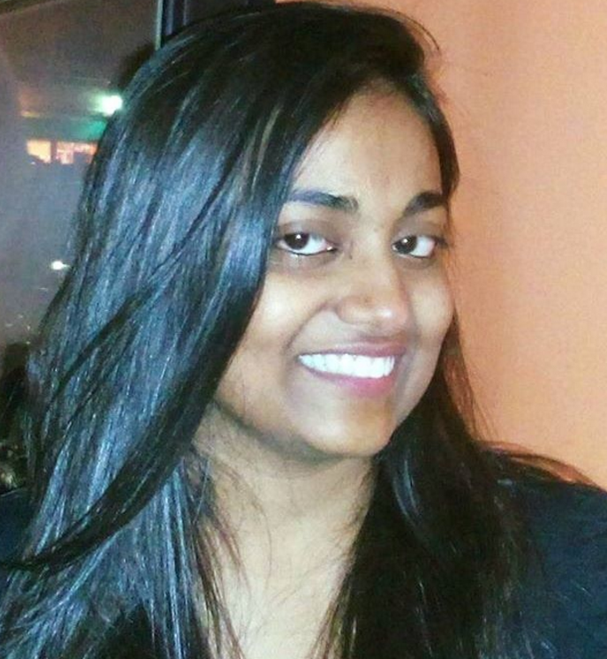
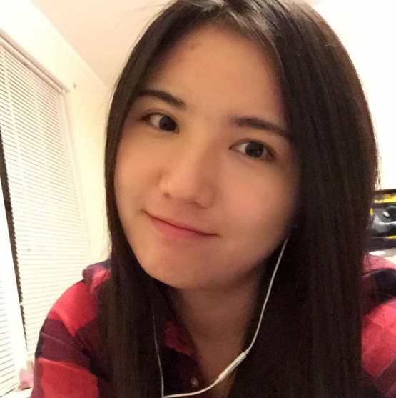
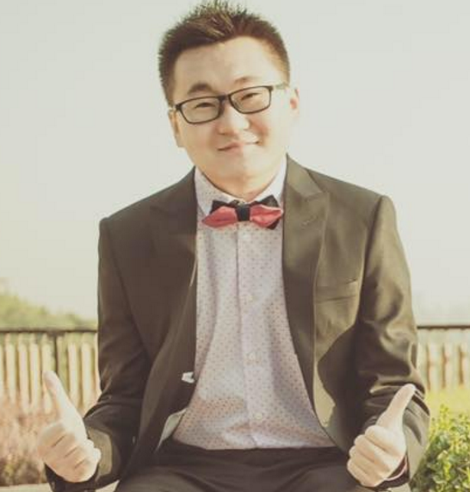
Our Team
Leader
Member
Member
Priti
Yalin
Zhi
Priti is the team leader, who use R collect data, build model and deploy on the server.
Yalin use R to collect static and streaming data, and write back-end code by node.js
Zhi,use python to collect streaming data, and design the architecture & framework of whole website.

Slide 3
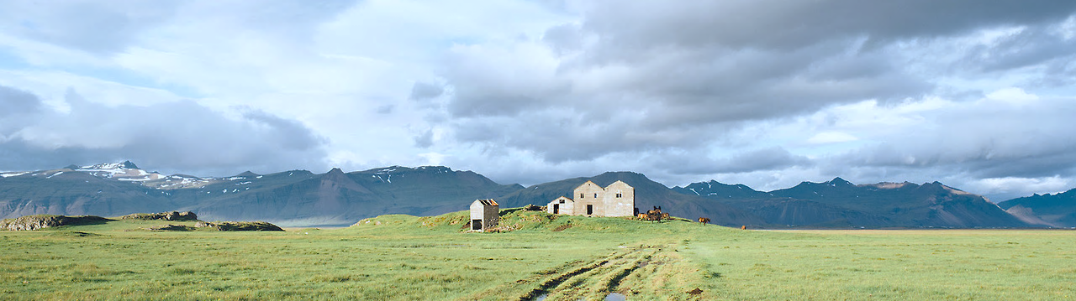
Project Guide
Introduction
Model Part
Deployed

Slide 4

PPT模板下载：www.1ppt.com/moban/ 行业PPT模板：www.1ppt.com/hangye/
节日PPT模板：www.1ppt.com/jieri/ PPT素材下载：www.1ppt.com/sucai/
PPT背景图片：www.1ppt.com/beijing/ PPT图表下载：www.1ppt.com/tubiao/
优秀PPT下载：www.1ppt.com/xiazai/ PPT教程： www.1ppt.com/powerpoint/
Word教程： www.1ppt.com/word/ Excel教程：www.1ppt.com/excel/
资料下载：www.1ppt.com/ziliao/ PPT课件下载：www.1ppt.com/kejian/
范文下载：www.1ppt.com/fanwen/ 试卷下载：www.1ppt.com/shiti/
教案下载：www.1ppt.com/jiaoan/ PPT论坛：www.1ppt.cn
0 1
INTRODUCTION

Slide 5
Functions of Whole System
Tableau
Dataset
S
T
Conduct exploratory data analysis by using Tableau
Find key words and collect static and steaming data. Then clean the data
Deployed
Model
M
D
Deploy the R and node.js system contact with model by REST API on Heroku and Rshiny.
Using R and AML to build Twitter Sentiment Streaming Analysis Model

Slide 6
DATASET
Key Words
Choosing key words for searching data ad use in the model
C
K
Collect
Collect static data and streaming data by using R and Python.
C
S
Clean
Clean the data which delete mess data and symbol.
Score Label
Calculate the score label, and make classification.

Slide 7
PPT模板下载：www.1ppt.com/moban/ 行业PPT模板：www.1ppt.com/hangye/
节日PPT模板：www.1ppt.com/jieri/ PPT素材下载：www.1ppt.com/sucai/
PPT背景图片：www.1ppt.com/beijing/ PPT图表下载：www.1ppt.com/tubiao/
优秀PPT下载：www.1ppt.com/xiazai/ PPT教程： www.1ppt.com/powerpoint/
Word教程： www.1ppt.com/word/ Excel教程：www.1ppt.com/excel/
资料下载：www.1ppt.com/ziliao/ PPT课件下载：www.1ppt.com/kejian/
范文下载：www.1ppt.com/fanwen/ 试卷下载：www.1ppt.com/shiti/
教案下载：www.1ppt.com/jiaoan/ PPT论坛：www.1ppt.cn
0 2
Tableau

Slide 8

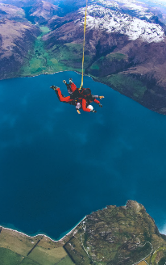
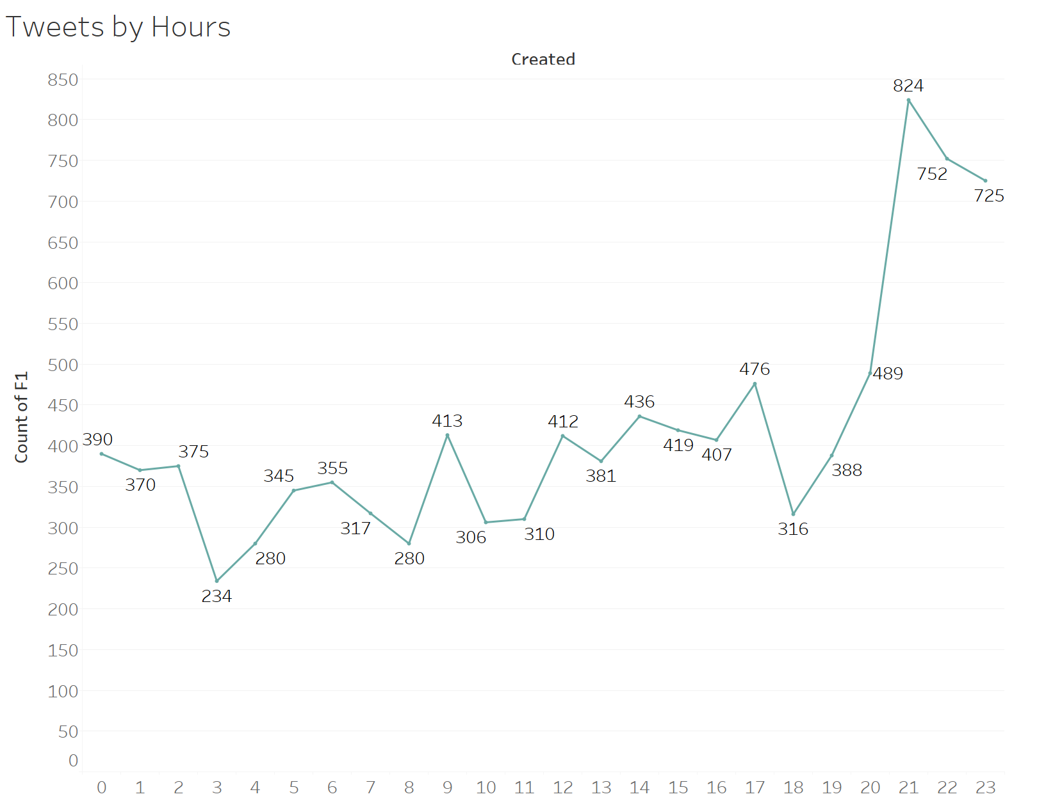
Tweets by Hours
9 PM
3 AM
Your Analysis
824 tweets
234 tweets
Everyday at 9pm, there are the most people use iPhone to write tweet.

Slide 9
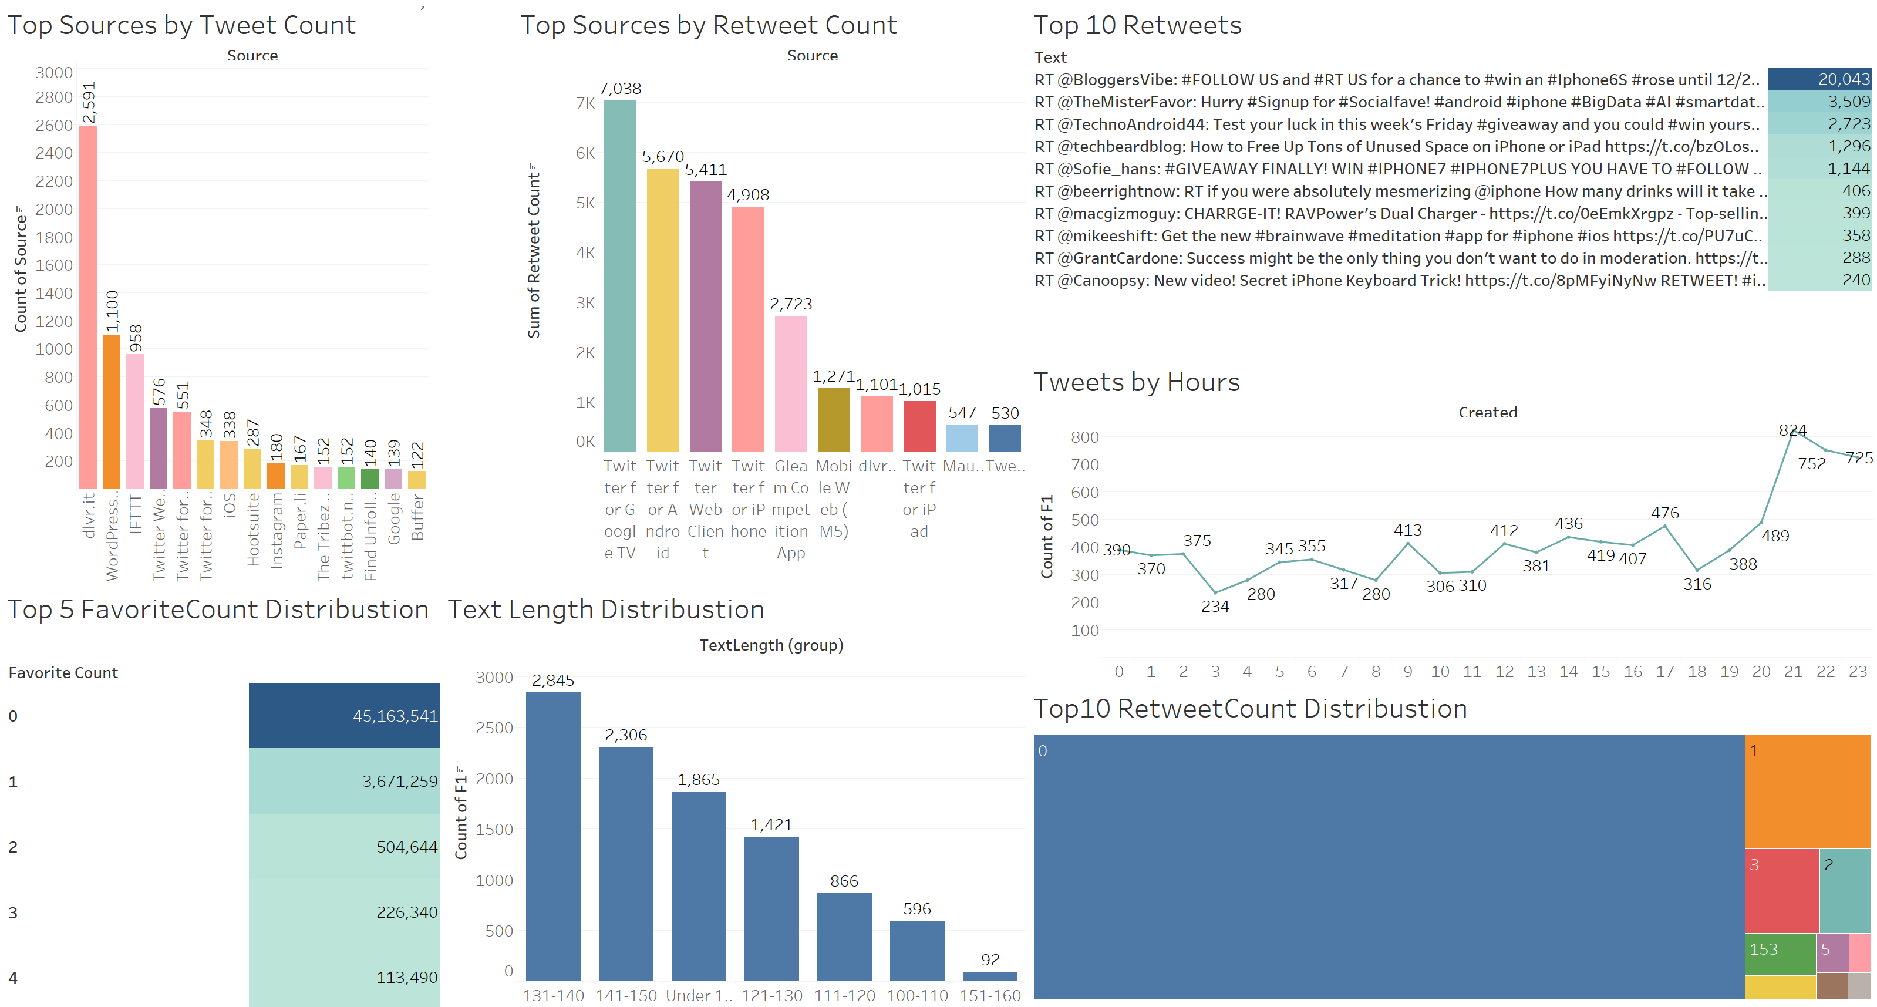
Tableau Dashboard:iPhone

Slide 10
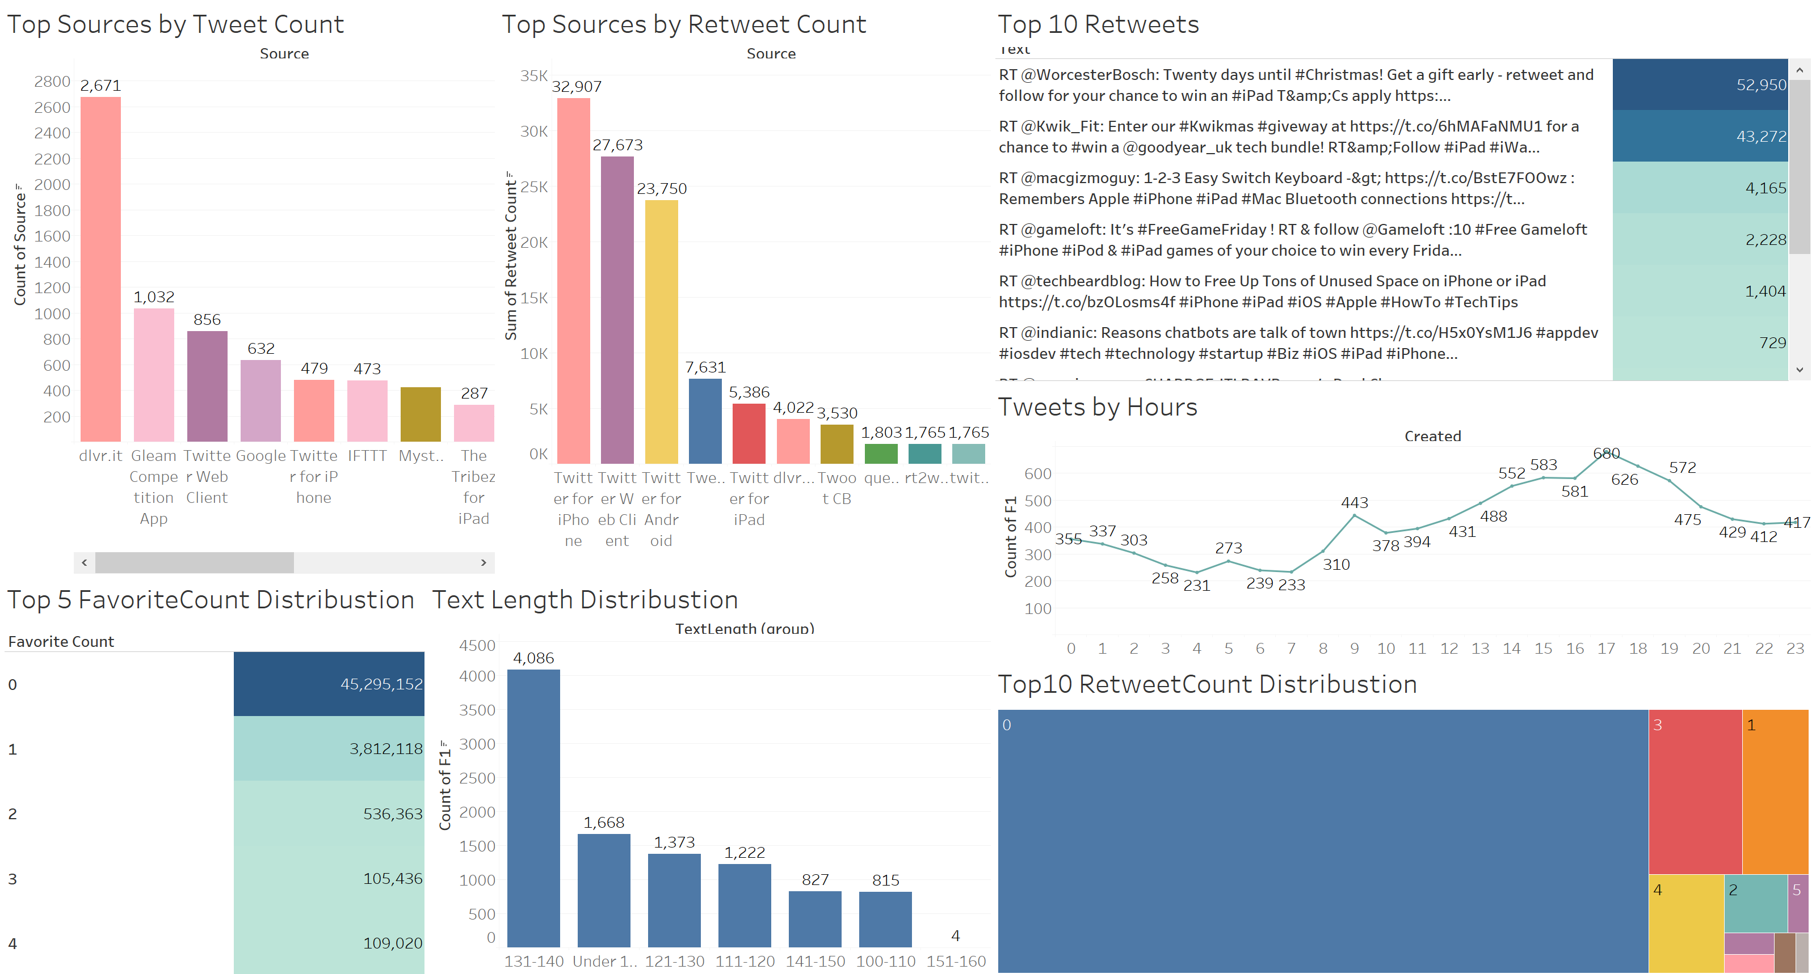
Tableau Dashboard: iPad

Slide 11
0 3
Model

Slide 12
Our Model Design
Text Preprocessing using R
Feature Engineering
Train prediction model
Evaluate model performance
Split the Data
Unstructured text such as a tweet usually requires some preprocessing before it can be analyzed.
Filter Based Feature Selection module to select a compact feature subset from the exhaustive list of extracted hashing features.
Split the data into train and test sets by 80% and 20% in each
The parameters used in the Two-Class Support Vector Machine module
Evaluate Model module, to get the evaluation metrics (ROC, precision/recall, and lift) shown in the following charts.

Slide 13
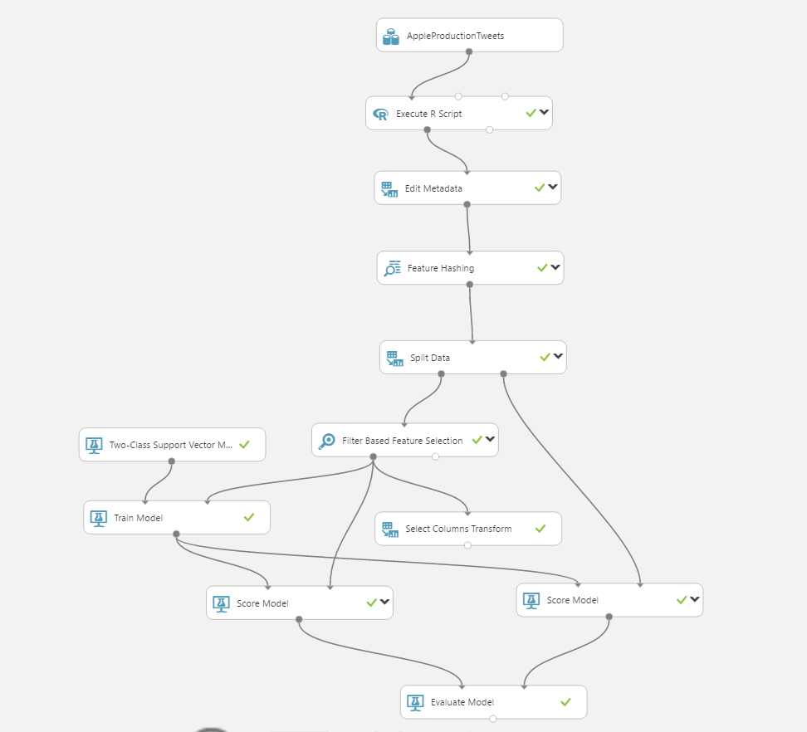
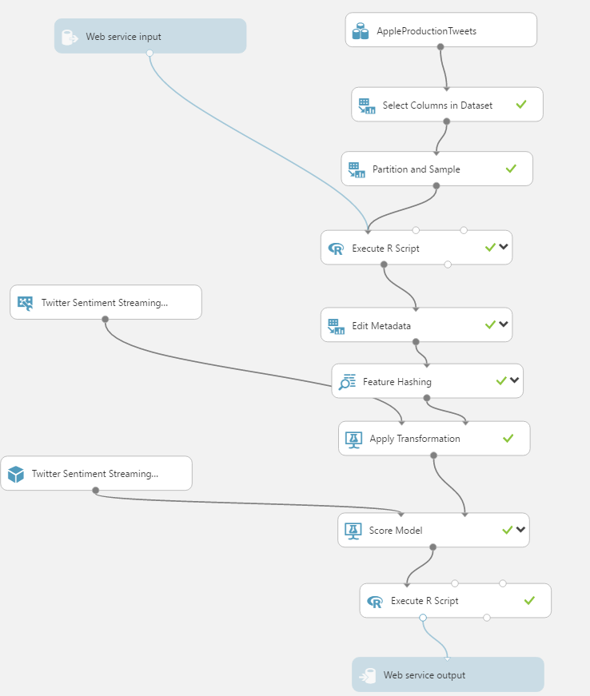
Azure Machine Learning Model

Slide 14
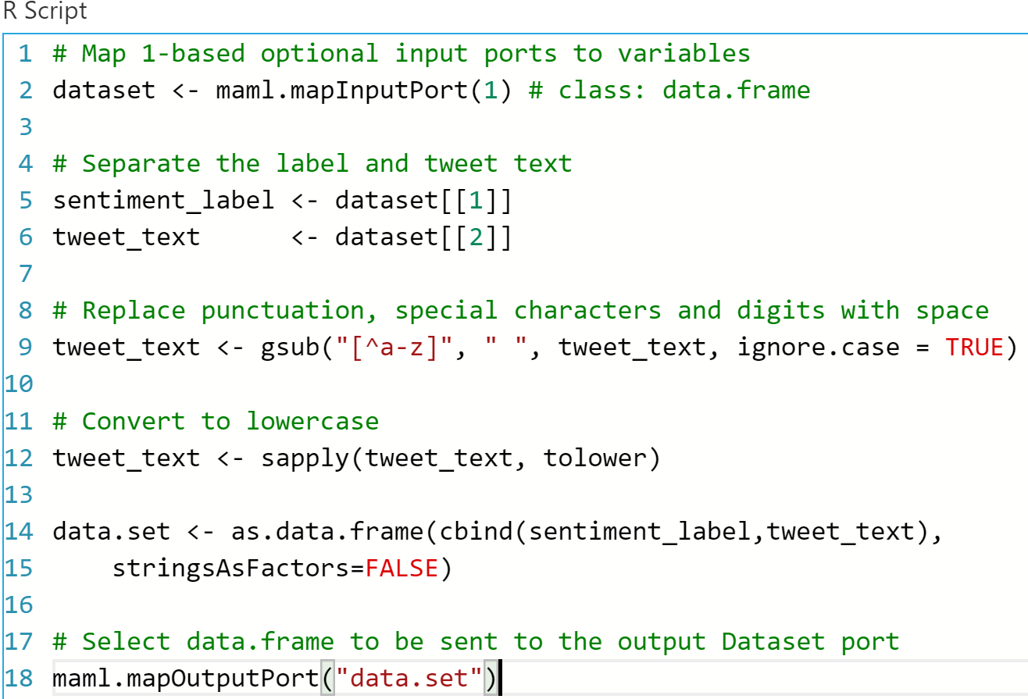
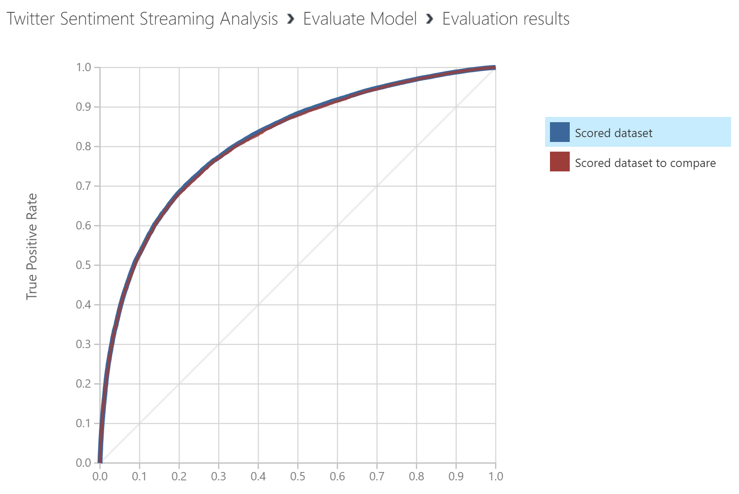
Azure Machine Learning Model

Slide 15
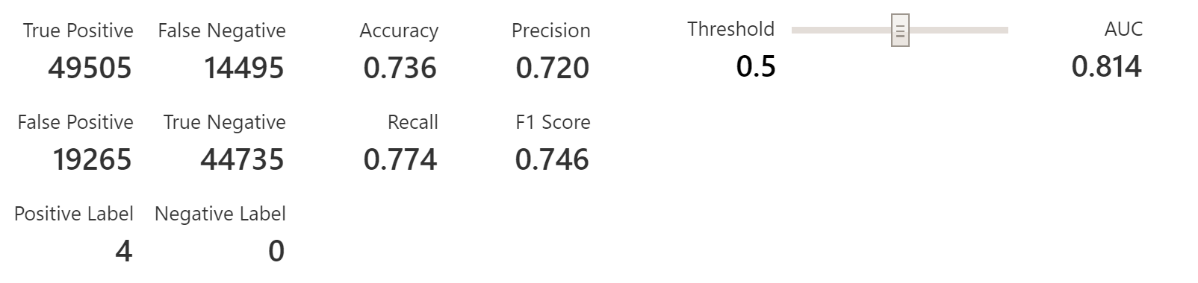
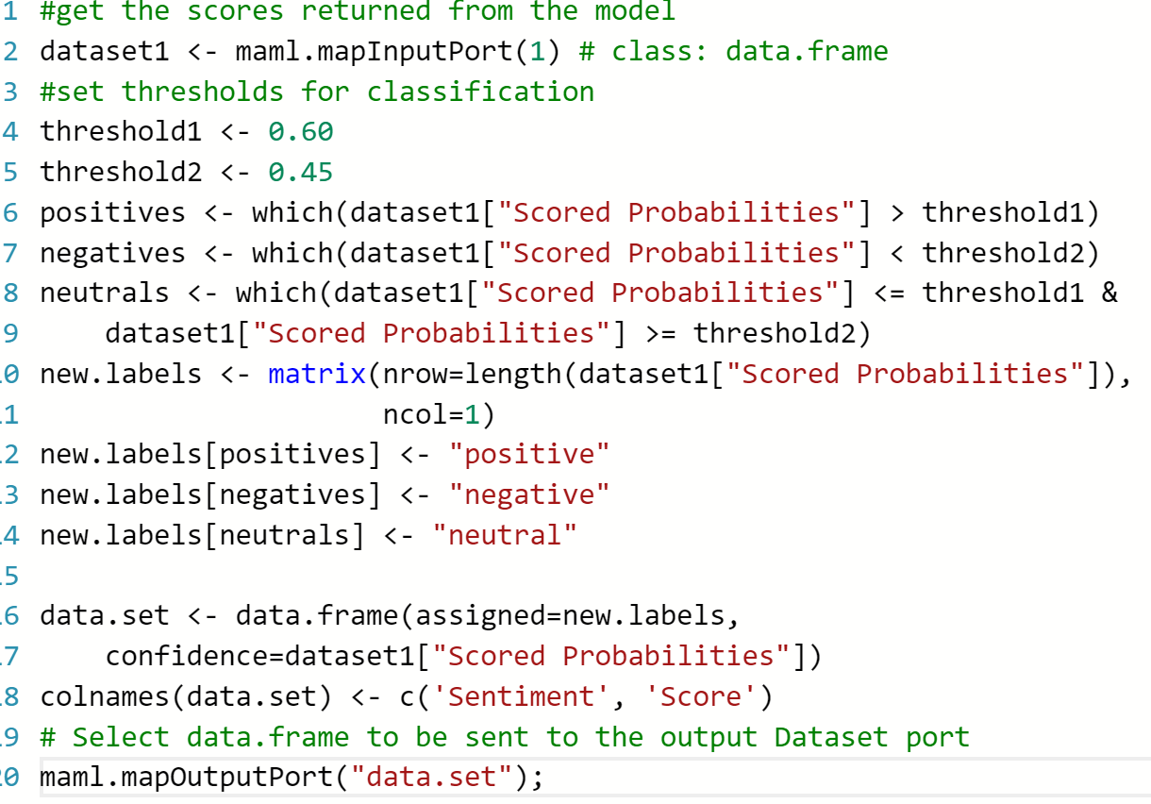
Azure Machine Learning Model

Slide 16
0 4
Deployed

Slide 17
Deployed Steps
Step 01
Create front-end webpage
Step 03
Put streaming data into AML by using Mode API
Step 05
Step 02
Step 04
Build environment by using node.js
Using Twitter API to collect streaming data.
Get output from Model and Present on Webpage dynamicly
100% done

Slide 18
0 4
Web Page

Slide 19
Our Program Language
jQuery&jQuery UI
HTML&CSS& Bootstrap
Node js
JavaScript
AngularJs
Javascript supports many dynamic effects
HTML5, CSS and Bootstrap using for whole basic framework.
Framework and Supports Dynamic effects
Supports Dynamic effects
Node.js is the backend platform for create framework and connect with REST API.

Slide 20
0 4
Live Twitter Dashboards

Slide 21
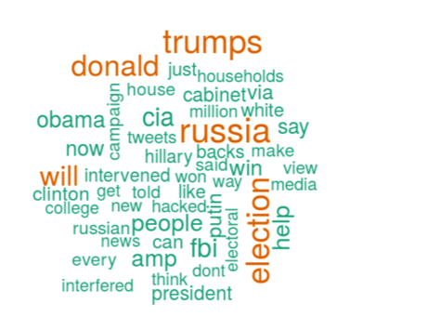
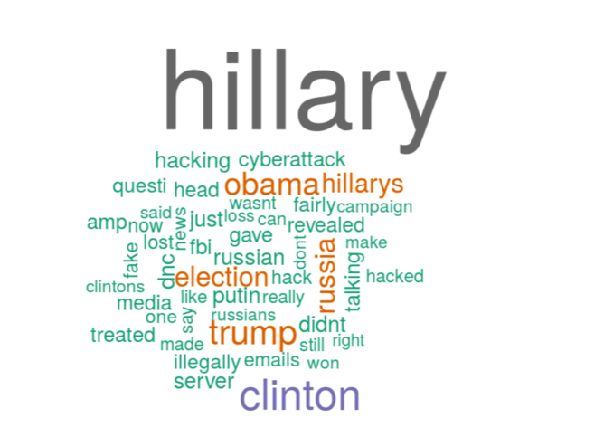
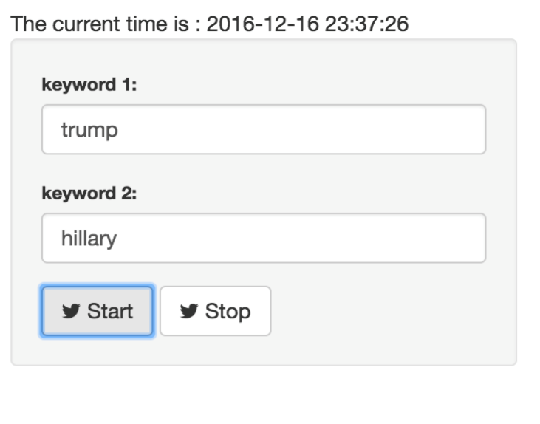
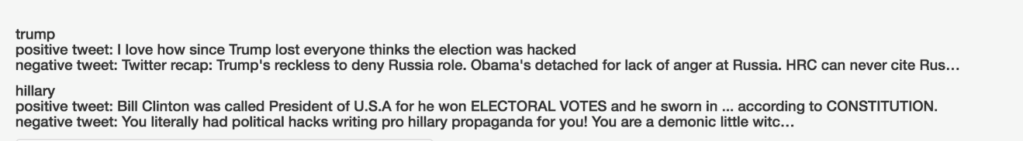
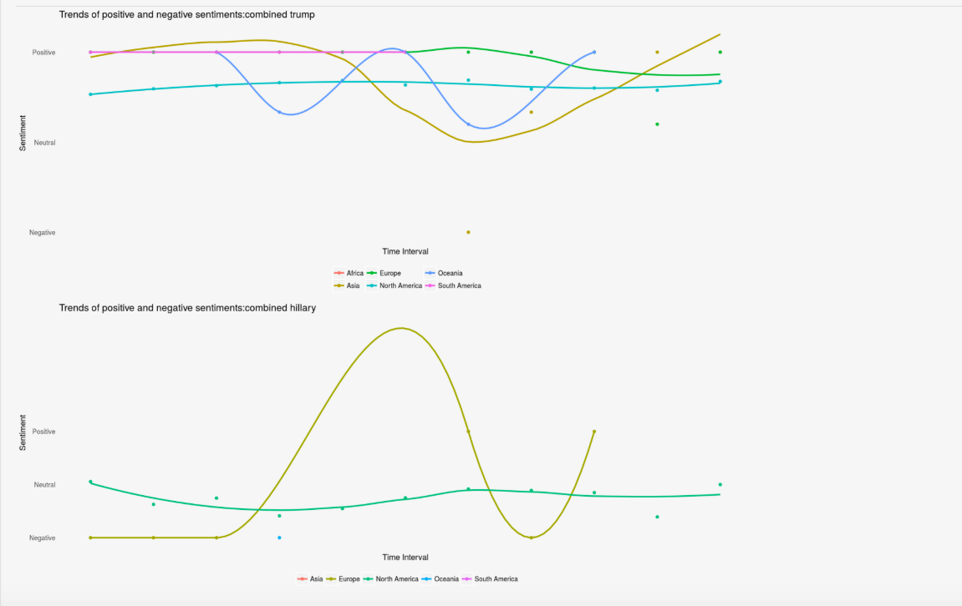
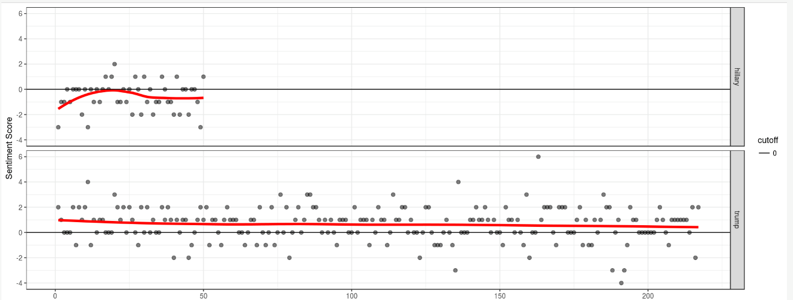
Live Twitter Stream Analysis

Slide 22
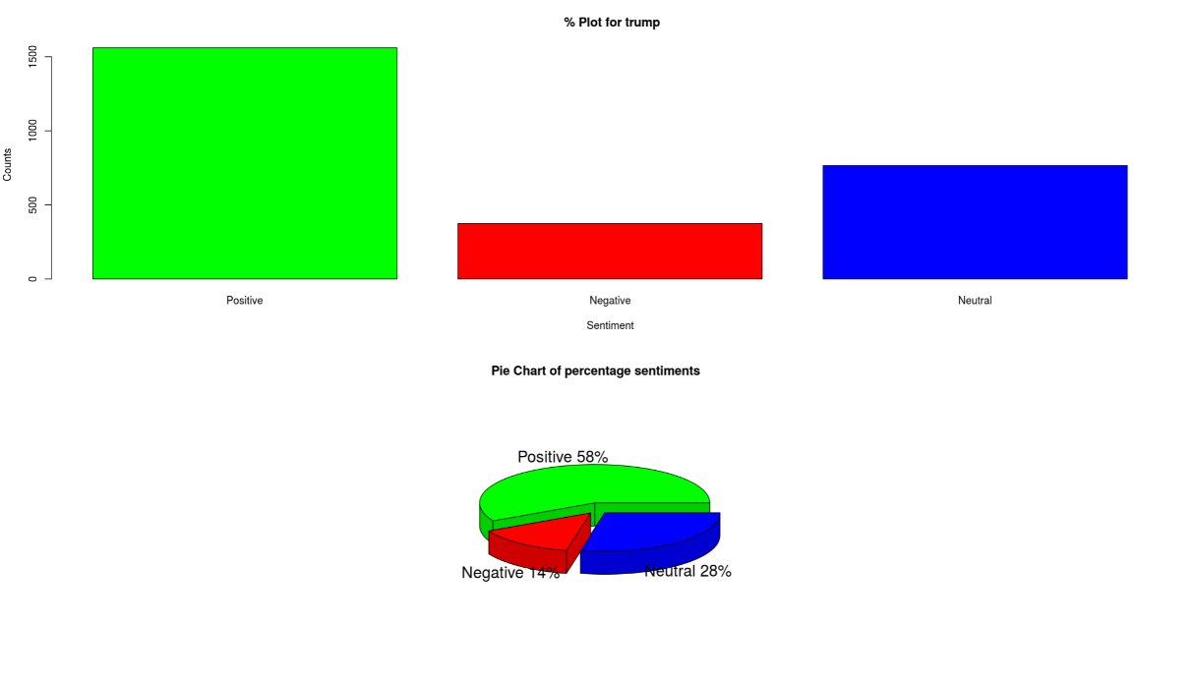
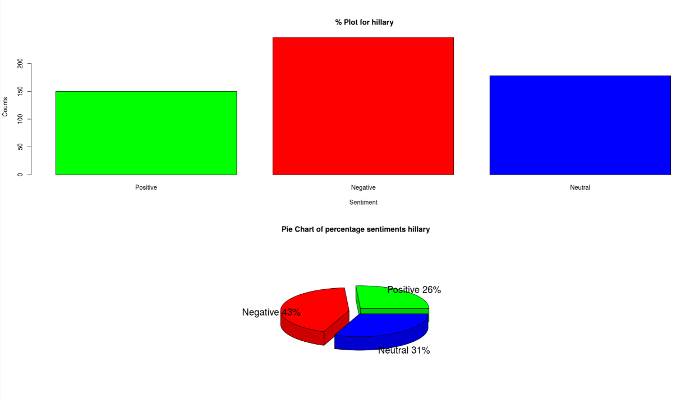
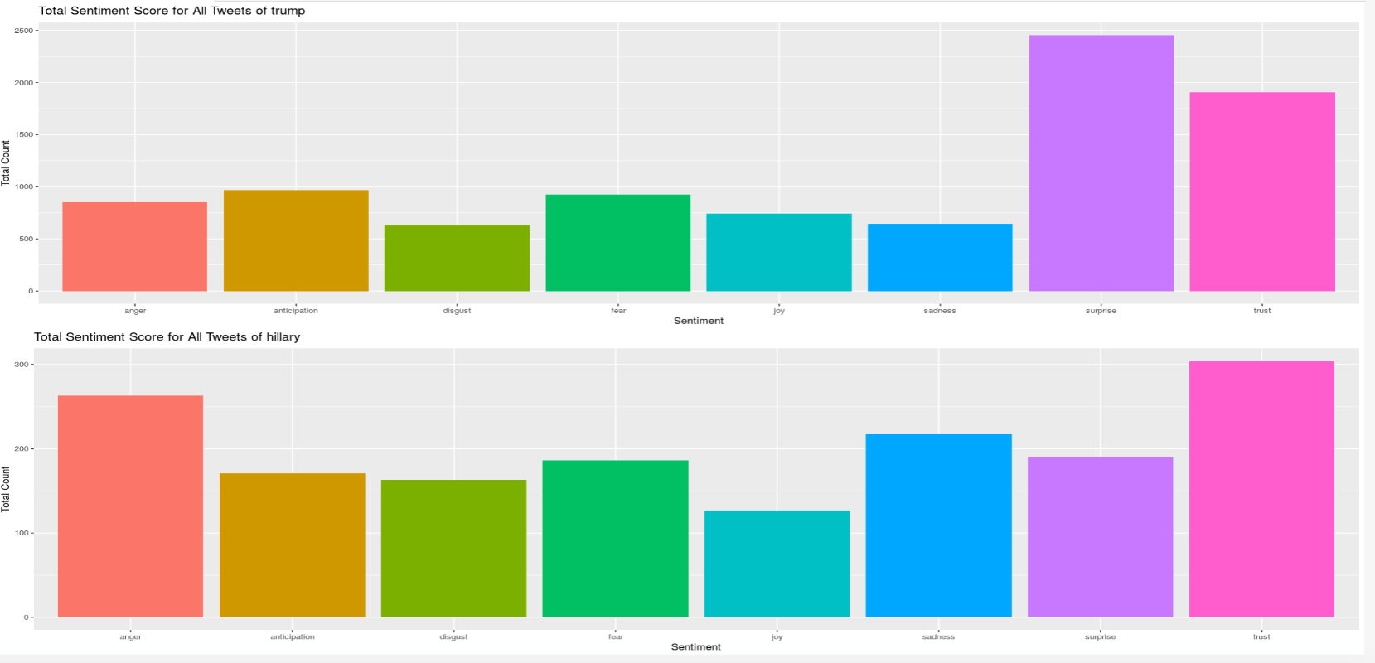

Slide 23
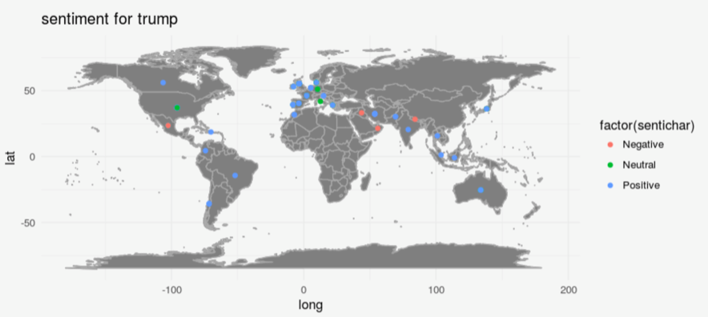
Plots World Map
Trump
Europe
Asia
Lots of Positive
More on Neutral
Africa
Australia
Some positive.
Most Negative.

Slide 24
Plots World Map
Hillary
Europe
Asia
Lots of Positive
More on Negative
Africa
Australia
Some positive.
Most Negative.

Slide 25
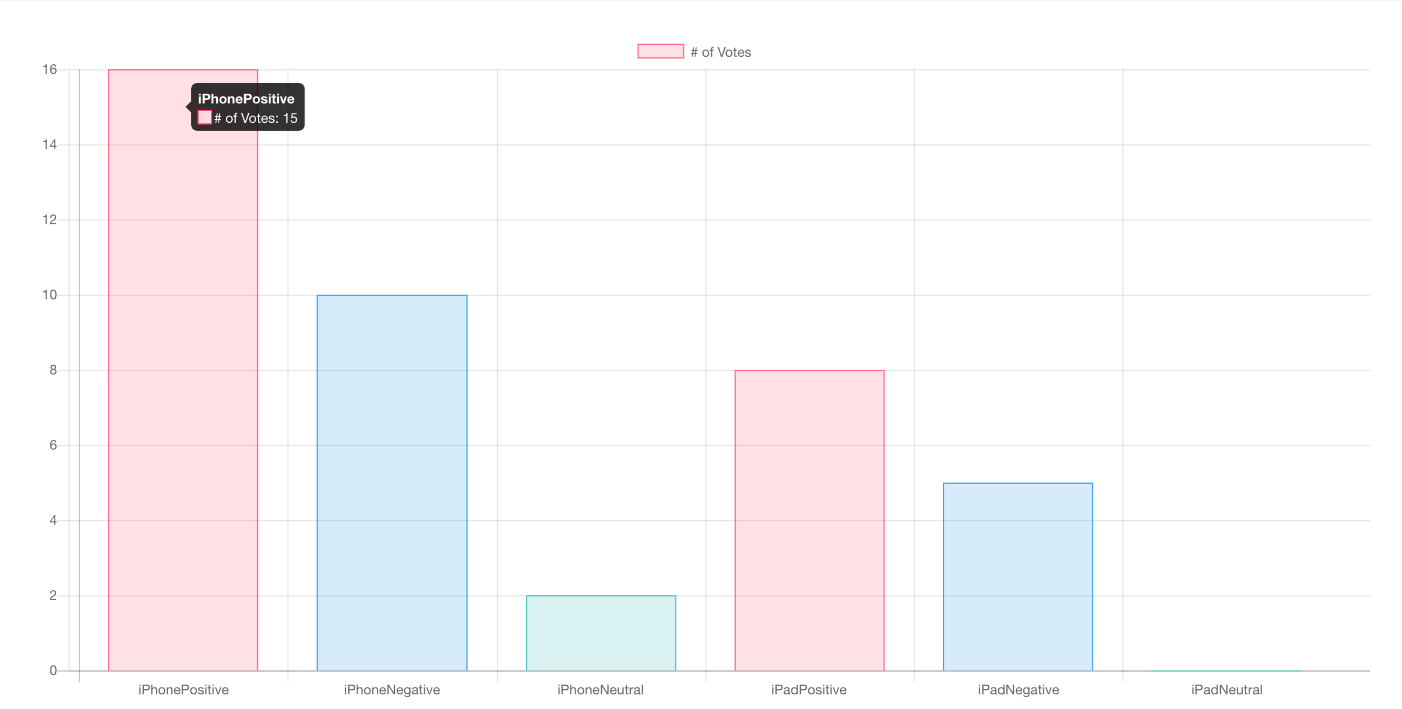

Slide 26
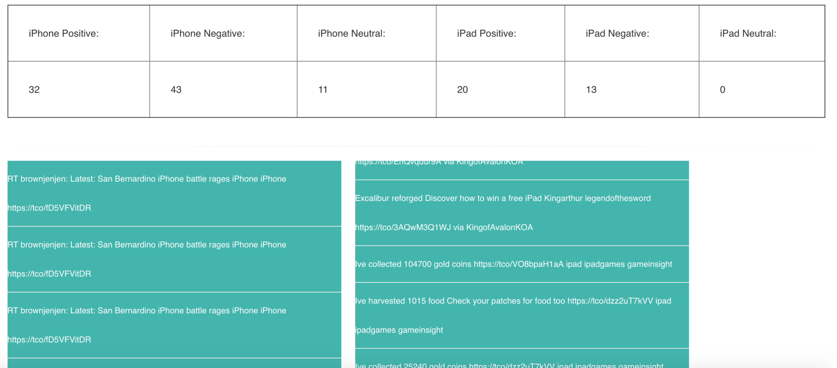

Slide 27
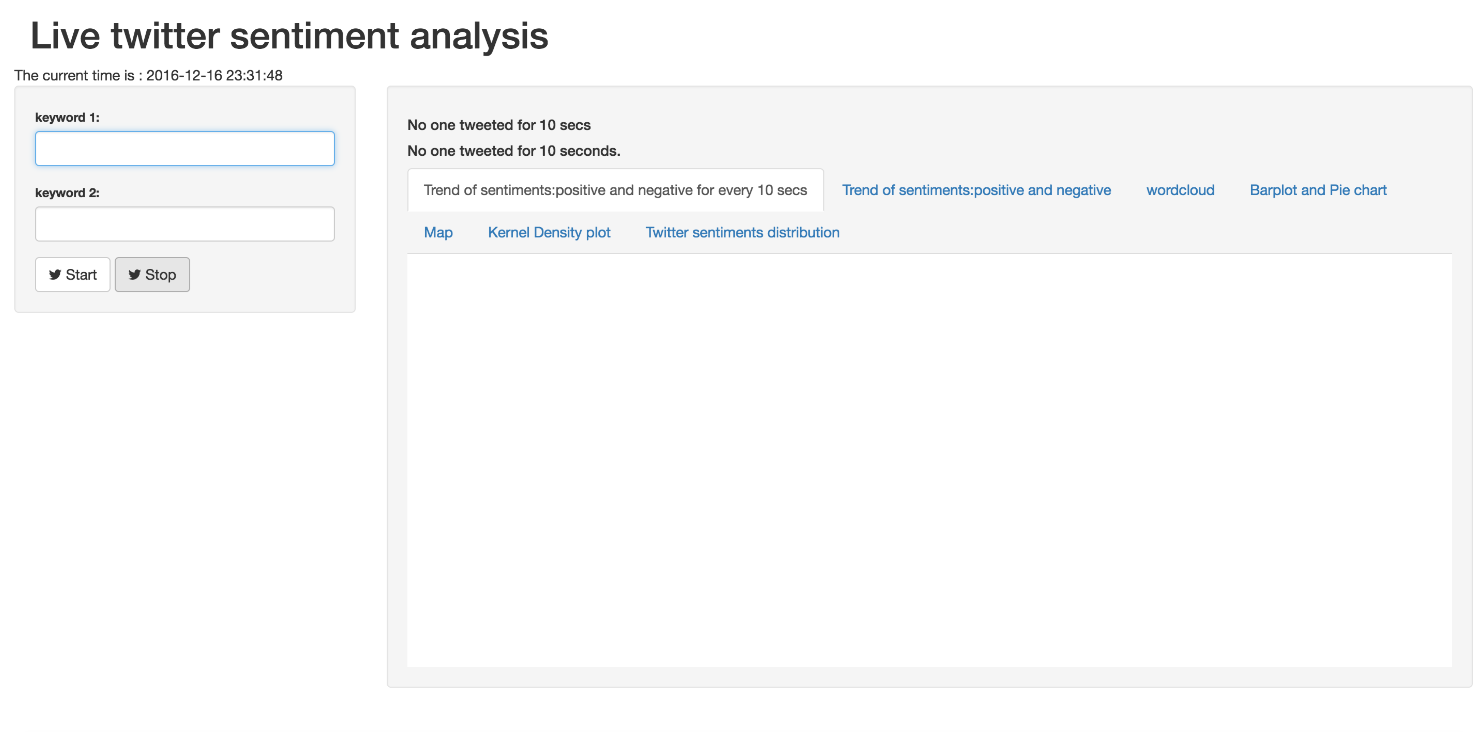

Slide 28
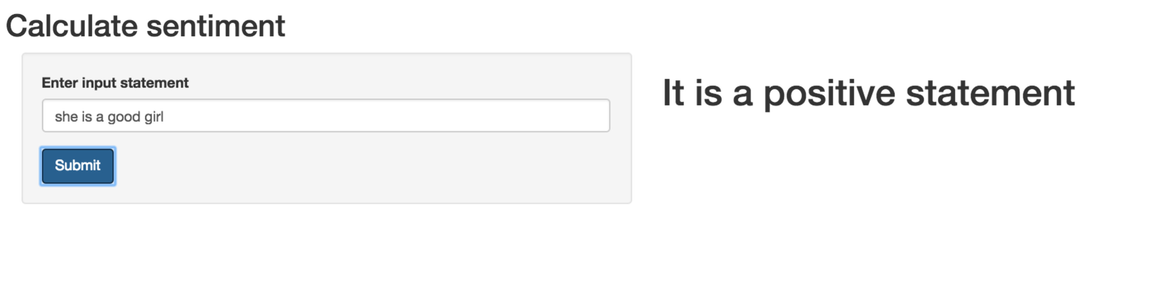

Slide 29
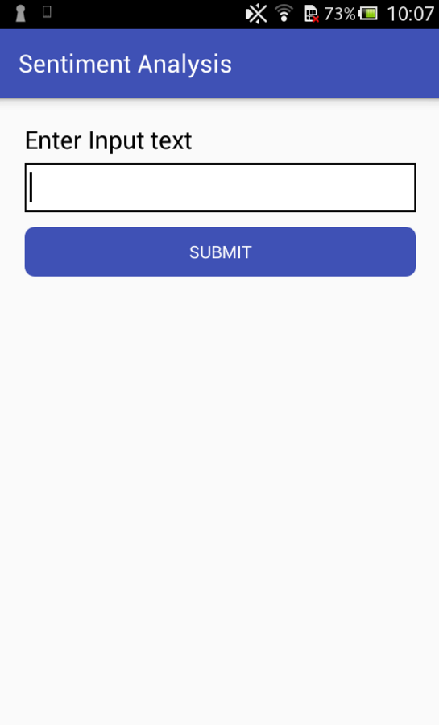
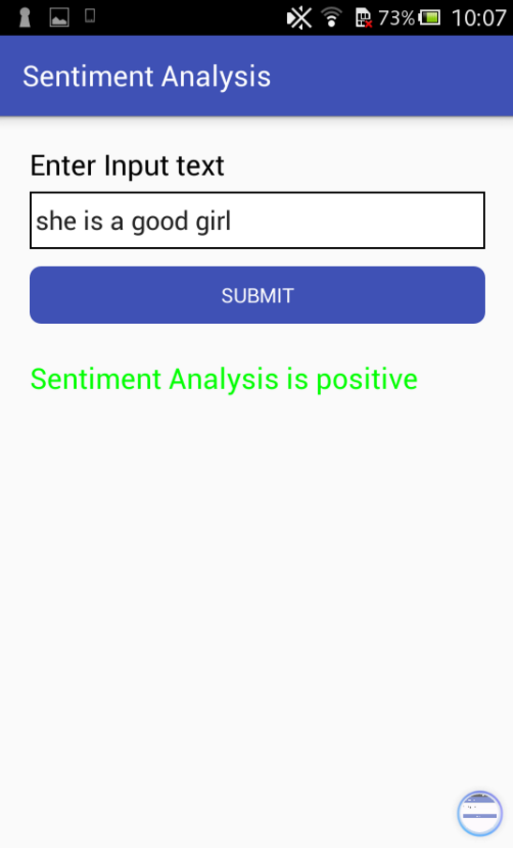
Android Application

Slide 30
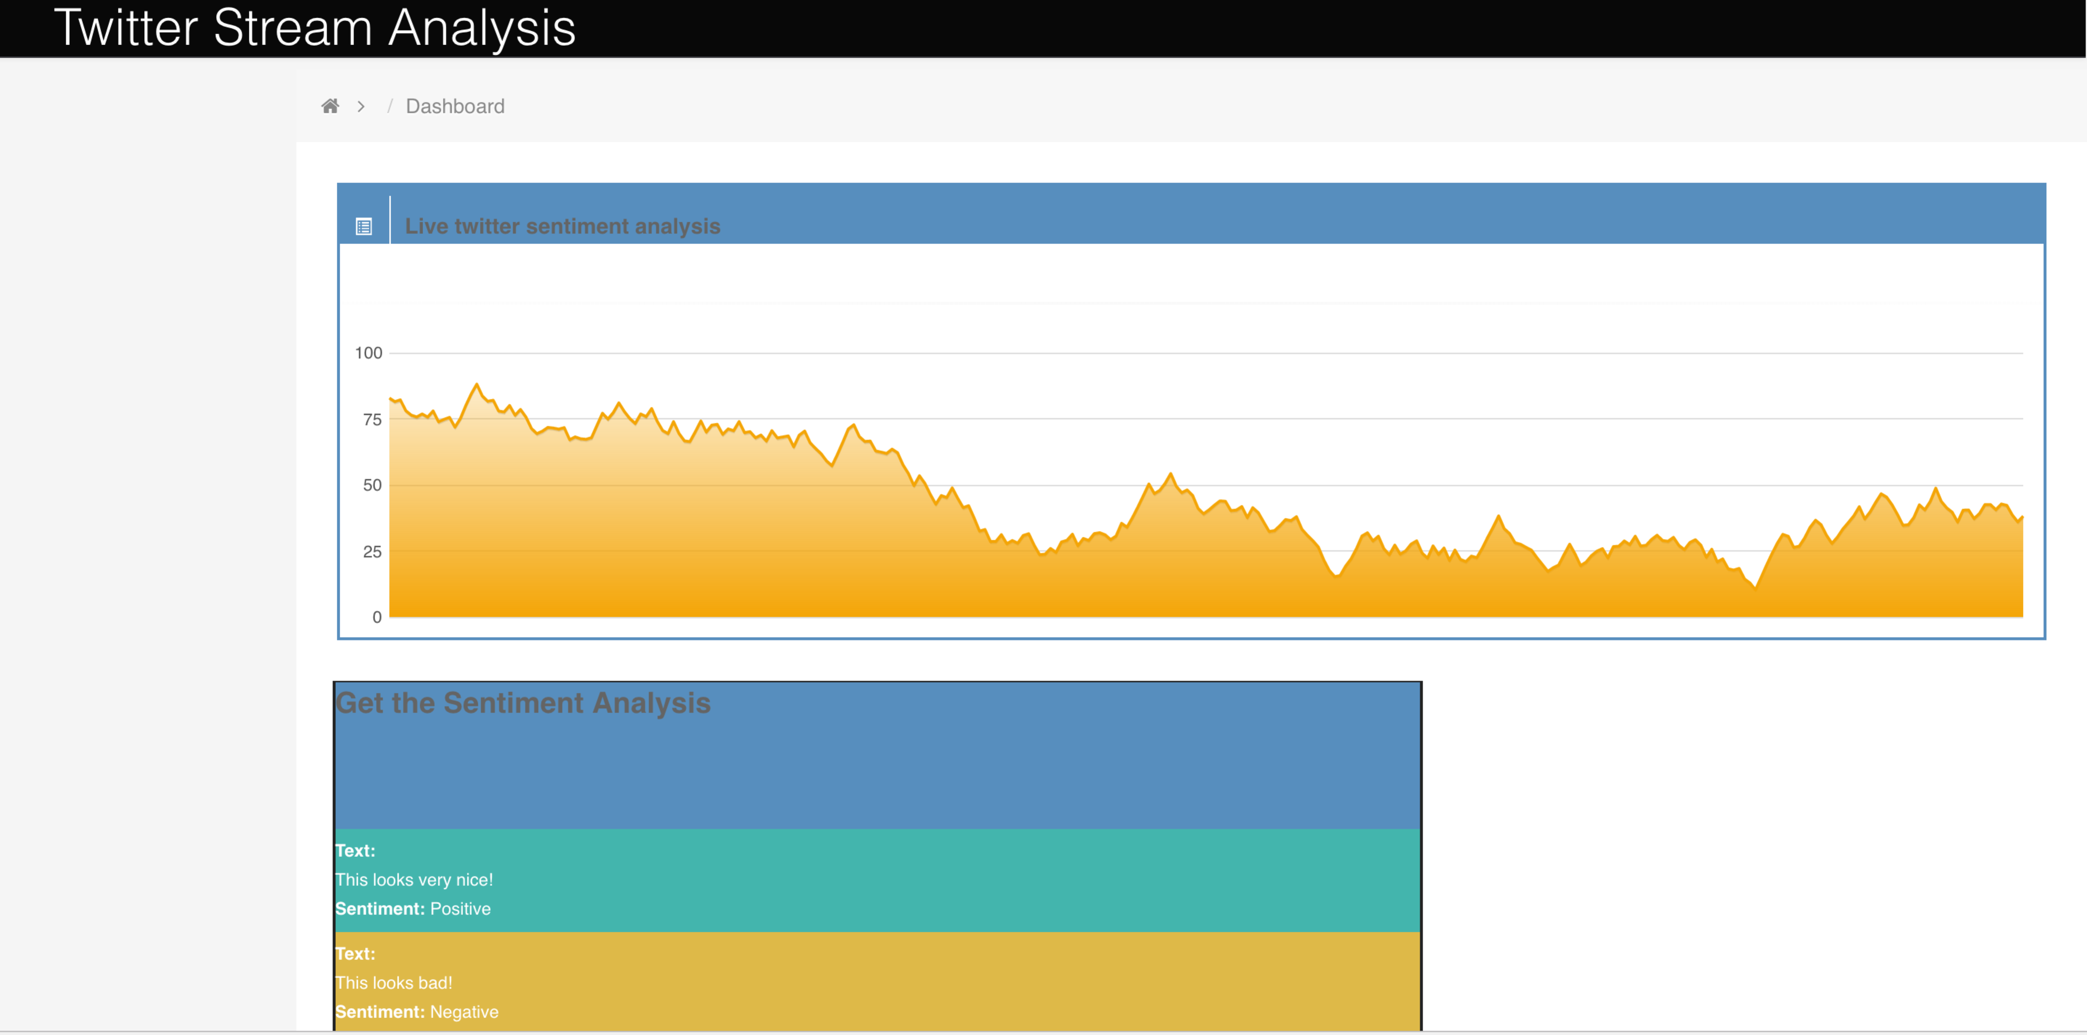
Final Website

Slide 31
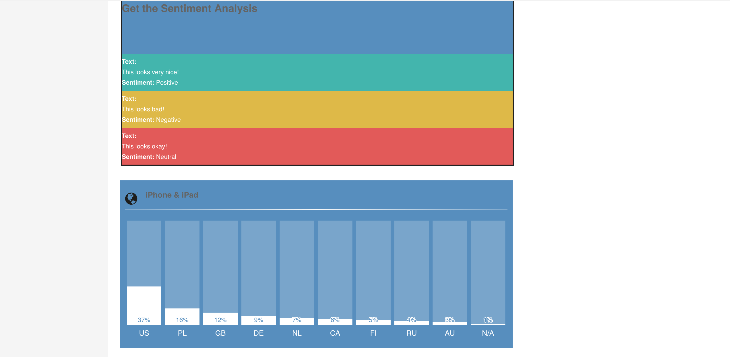

Slide 32
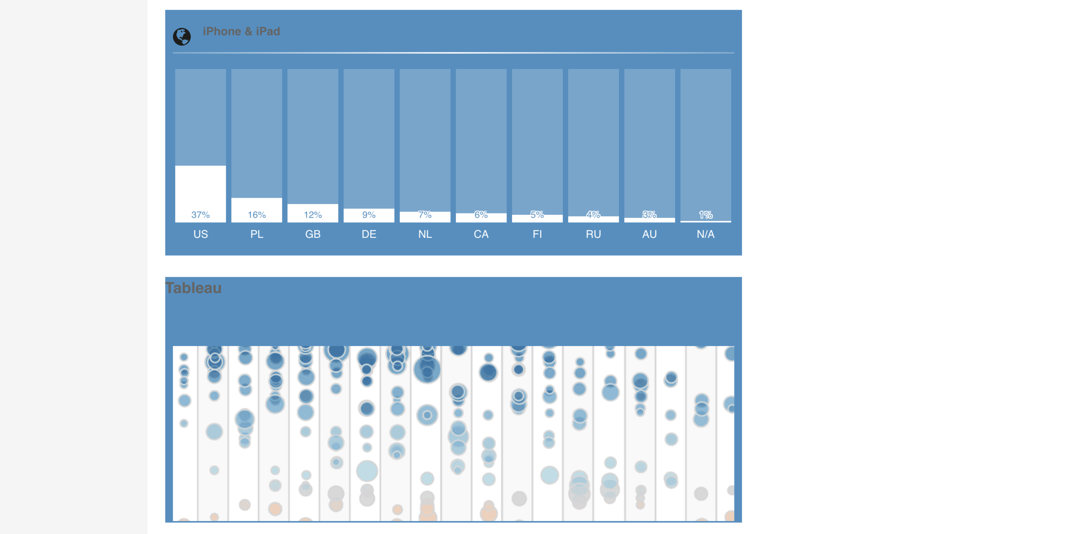

Slide 33
THANK YOU
Q & A?
Team12
Priti, Yalin, Zhi

